Slide 1
A Data Analysis & Visualization Tool to Facilitates Immunotherapy Research
Emily Feiping Li
Prof. Wooyoung Kim
Prof. Yang Peng
Prof. Geetha Thamilarasu
Notes:
Thank you for being here for my final defense presentation this morning.

Slide 2
Outline
Motivation
Background
Project & Demo
Evaluation
Future Works

Slide 3

Motivation
Support Immunotherapy research
Build an adaptive immune system to identify and kill cancer cells
Notes:
Our motivation is simple and straight: support immunotherapy research to find a better treatment for cancer. This a project that will make impact on real life, and will save cancer patients from suffering.
Next I will compare immunotherapy with chemotherapy which is a standard treamt for cancer.

Slide 4
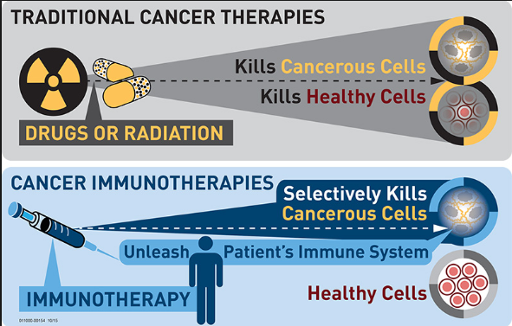
Background – Cancer Treatments
Chemotherapy
Severe side effects
Immunotherapy
Promising Future
https://www.sanfordhealth.org/sioux-falls/services/head-neck-cancer/research/cancer-immunotherapy
Notes:
Chemotherapy It uses drugs that kill fast-growing cancer cells. However, it has severe side effects. because the drugs travel though patients’ body, normal, healthy cells that are fast-growing are affected too, including cells in human’s blood, mouth, digestive system, and hair. Patients suffer from the side effect.
Immunotherapy treats cancer with less side effect. It strengthens the power of a patient’s immune system to identify and only kill cancer cells, without touching the healthy cells. Immunotherapy has been proved effective by researchers.
Let talk about how immunotherapy works.

Slide 5
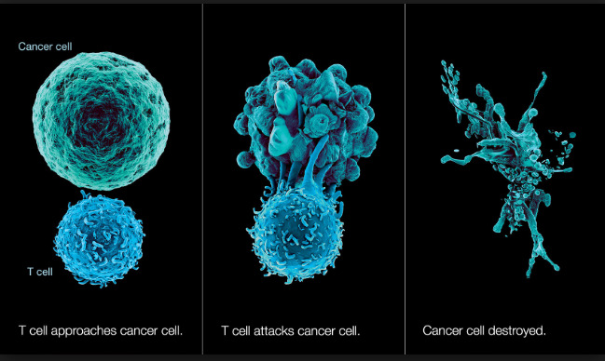
Background – Immunotherapy
Cancer cell
T cell
https://www2.estrellamountain.edu/faculty/farabee/biobk/BioBookIMMUN.html
Notes:
Immunotherapy leverages T cells to build an adaptive immune system that can identify and kill cancer cells. Because our immune system does not recognize Cancers cells as foreign or dangerous. Therefore, The Key is how to make T cells to have the ability to recognize cancer cells. In order to kill cancer cells, let me first explain how T cells and immune system work together to fight against foreign substance.

Slide 6
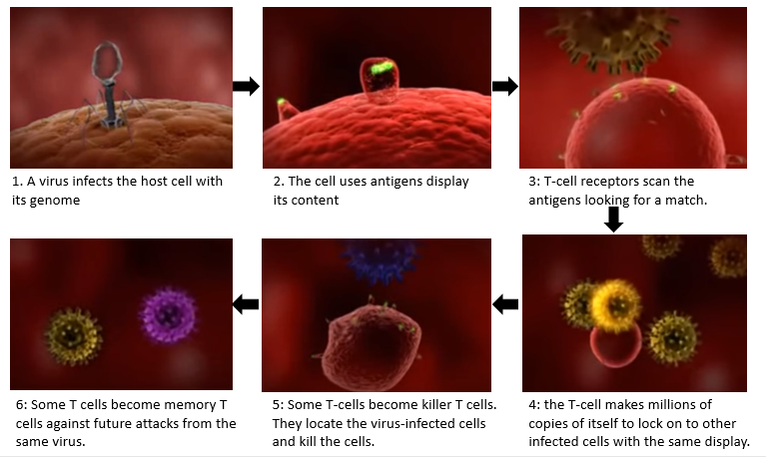
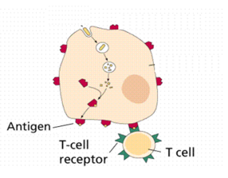
Background – Immune system & T Cells
Notes:
Immune system fights against foreign substances such as virus. A typical immune response against virus includes 6 steps.
a virus infects the host cell. the virus commandeers the cell by getting inside the cell.
the human body has a strategy to survey aliens even they are hide inside of its own cells. Cells use antigens to display a sample of its contents including the virus. Antigens cover the surface of cells and it is similar to the barcodes on the outside of packages at the grocery store.
T-cells user T cell receptors to scan those antigens on a cell. T-cell receptors are also proteins that stays on the surface of T cell. This picture shows a close look at the T-cell receptors and antigens. When a given T cell receptor does fit well with an antigen, it signals the immune system to mount an immune response.
While still bound to the antigen, the T-cell making millions of copies of itself so that more T-cells can lock on to other infected cells with the same display.
A subset of these T-cells change and become killer T cells. Those killer T cells locate the virus-infected cells and puncture them, effectively killing them.
Finally, a certain subset of the activated T cells become memory T cells forming an army against future attacks from the same virus.
You can see the activation of the T-cells is crucial for immune system to mount a response.
So now I will go back to explain how to leverage the power of T cells for immunotherapy.

Slide 7
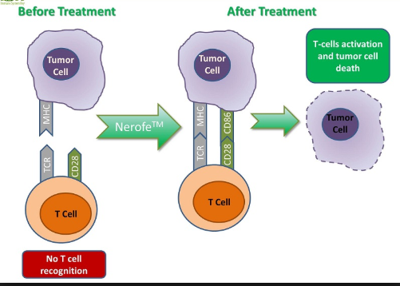
Background – Immunotherapy
Goal of Immunotherapy
To customize effective engineering T-cells and make tailored medicine for each patient
Researchers need
To investigate dynamic molecular processes that involved in T-cell receptors (TCR) activation and suppression
http://www.immunesk.com/breakthrough-cancer-immunotherapy-effects-of-nerofe/
Notes:
So for immunotherapy, the goal is to customize effective engineering T-cells and make tailored medicine for each patient. researchers collect samples from a patient, and test the sample with different proteins to find the combination of proteins that produce the most powerful T-cells. By discovering the best combination of proteins, researchers can make tailored medicine to cure the patient.
To achieve the goal, Researchers need To investigate dynamic molecular processes that involved in T-cell receptors (TCR) activation and suppression . That will improve researchers’ understanding of cancer pathogenesis and ability to control T-cells activation.
Next I will present QMI platform that makes great contributions to T-cells activation research.

Slide 8
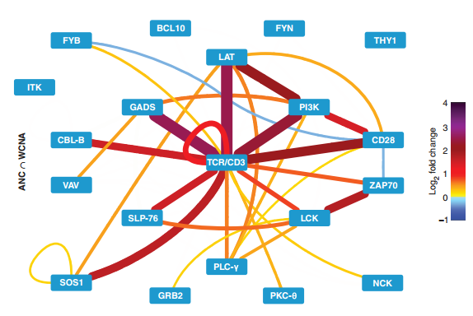
Background – QMI Platform
Quantitative Multiplex Co-Immunoprecipitation (QMI) Platform
Proposed by Dr. Stephen E. P. Smith in 2015
Contributions:
Generates protein-protein interactions to research the activation state of the T-cells
Using statistical analyses to provide doctors with necessary data for engineering T-cells
Can be applied to cure leukemia and autism.
Multiplex matrix network analysis of protein complexes in the human TCR signalosome, 2015.
Notes:
It was proposed by Dr. smith in 2015. Dr. smith is a professor from UW Seattle at the department of pediatric. He works with us and is our client.
QMI platform is an cutting-edge technology to generate PPI to research the activation states of the T cells. It also uses a set of statistical analyses to provide doctors with meaningful data for engineering T cells.
The left figure is a result of QMI platform, it shows the network of a TCR stimulation.
Dr.Smith’s lab wants to integrate this useful tool into end user labs. However, there are problems in term of QMI product that needs help from us.

Slide 9
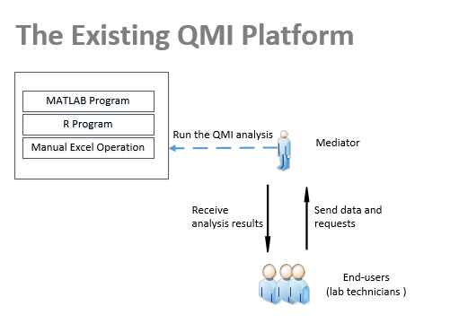
Project - Problems of Existing QMI Platform
Multiple programs running
Manual operations
Command-line interfaces
Time consuming in communication
Notes:
The 1st project is the existing QMI platform lacks usability to be adopted by end users.
The existing QMI, as shown on the picture, is implemented as different computer programs (Excel, MatLab, and R). The workflow requires the users to export data files, convert them to different formats, and manually input and manipulate data in command-line interfaces in R and MATLAB. There is no streamlined analysis process, operations are way too complicated for the end-users.
So that end users send data and request to SEPS lab staffs and they spend lots of time in communication back and forth. A single QMI analysis could take long, at least 30 minutes.

Slide 10
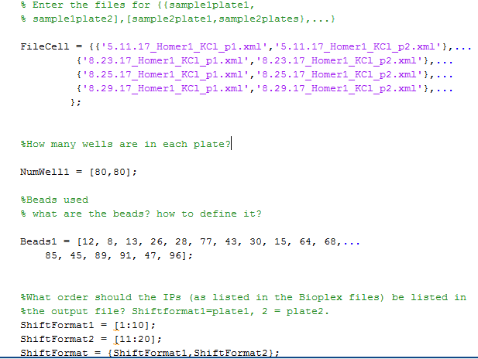
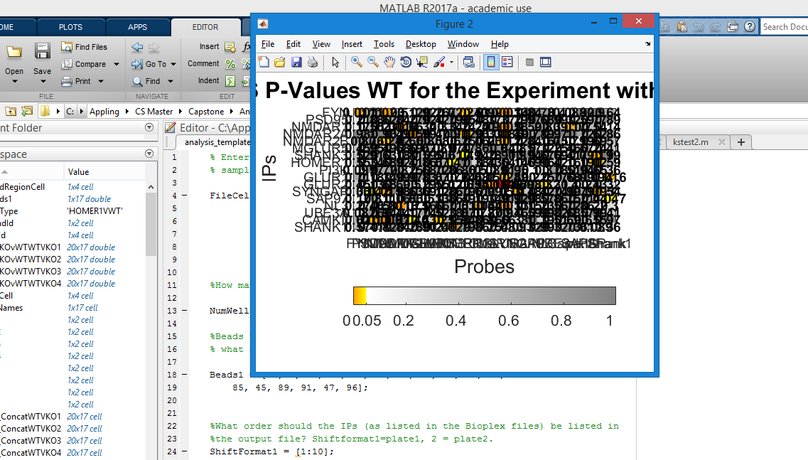
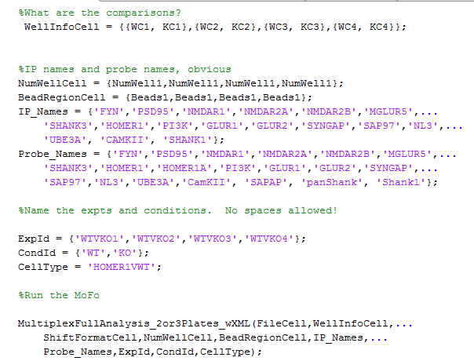
Project - Problems of Existing QMI Platform
(a)
(b)
A command line Interface
Results pop out unorganized
Notes:
Moreover, the existing QMI project lacks flexibility and visualization. As shown on figure a, that is a command line interface to set up a QMI analysis , users are required to familiar with details of QMI protocols and knows how to programming in MATLBA.
While QMI analysis starts, users are not allowed to change setting parameters, even the set up is wrong, they have to wait for all analysis finished.
Additionally, the current QMI lacks organization of results. As shown on figure b, basically all results pops up while the program is running, that prevent users from understanding the results.
We need to resolve these problems and help the integration of QMI platform into end user labs. Next I will explain how we design our project to resolve those problems.

Slide 11


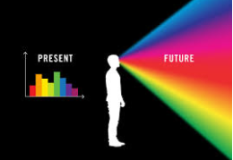
Project – Users’ Needs
A streamlined analysis process
Users can perform the QMI analysis by themselves with little or no knowledge about QMI, programing and statistics
Quick responses
Users can perform one QMI analysis within 10 minutes
Meaningful and visualized data presentation
Present analysis results logically with smooth transitions so that users can understand the results
Notes:
From perspective of users, to perform the a QMI analysis quick and easy, they need
A streamlined analysis process. Users can perform the QMI analysis without a mediator with little or no knowledge about QMI protocols, programing and statistics.
Quick response. We can’t let users wait too long. We expect the most complex QMI analysis can be done within 10 minutes.
Last but not the least, Present data and results visually so users can understand. Users should easily configure setting parameters for the QMI analysis. we shall present analysis results logically with smooth transitions so that users can understand the results.
Based on the needs of the users, next I will present our target deliverables for our project.

Slide 12
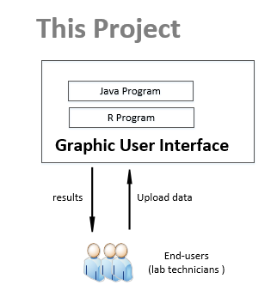

Project – Target Deliverables
Integration of scattered tools into a unified graphical user interface program
Fast responses
Meaningful visualizations
User-friendly interfaces
Notes:
Therefore, we integrate scattered existing projects into a united graphical user interface(GUI) program, which provides simple operations and visualization.
The steps with MATLAB program and manual excel operations are replaced by a Java program due to MATLAB license cost and low maintainability. The mediator is no longer needed cause users can use the GUI to easy perform QMI analyses by themselves. Next I will present design of our project.

Slide 13
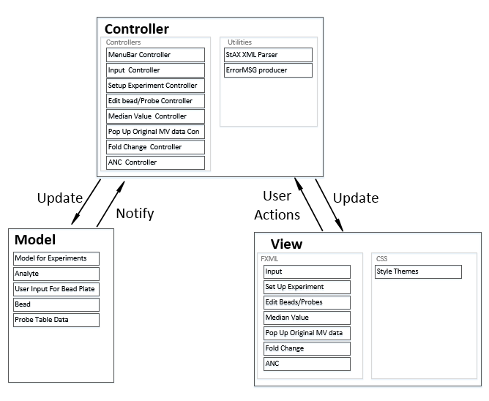
Architecture – Model-View-Controller
Keeps the layers of business logics and presentation separate
Alleviates the complexity of our project and makes testing and maintaining easy
Notes:
We choose a Model-View-Controller framework to keep the layers of business logics and presentation separate. The Model is basically a black box representing the application and its data. The “View” displays the data from the model and passes commands and data back to update the application. The “Controller” mediates between the “Model” and “View”, presenting data to the “View” and commands to the “Model” .
Since we choose JavaFx for our project, so we cleanly separate work as models (domain objects), views (FXML, CSS), and controllers (Java classes ).
MVC reduces the complexity of our large application and makes testing and maintaining easy.

Slide 14
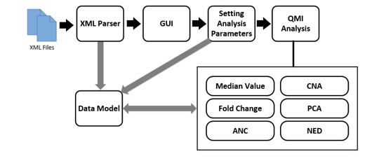
Architecture – Dataflow
Notes:
Here shows data flow of our project. Our project requires XML files which contains initial data on T-cells activation as input.
As a first step, the system parses XML files to acquire raw data for further processing, and save the raw data in to a data model.
Subsequently, the default parameters setting is shown on the GUI based on users’ inputs, which can be edited easily if that’s not what users want, the changes are saved to the data model as well.
Finally, a user performs QMI analyses, the results are presented on the GUI and also saved into the data model, so that we can provide fast Reponses in case users go back to check pervious steps.

Slide 15
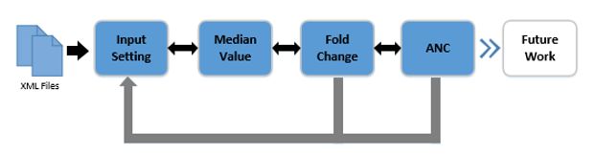
Demo – Steps to run an QMI analysis
Notes:
Here I am going to show a demo of our project based on the steps to run a QMI analysis.
The project is not complete, we has finished the input setting, median value, fold change, ANC. We have 3 more analyses to be finished in future.

Slide 16
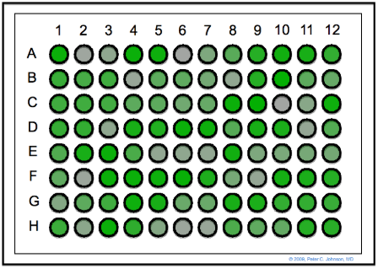
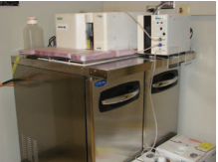
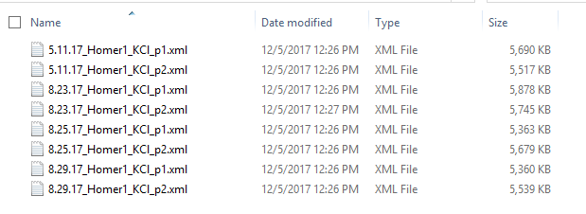
Demo – XML Files
Notes:
The input XML files are generated from a Bioplex 200 instrument as show on the left picture. The machine performs an initial observation on T-cells which are generated from control patients’ biopsy samples. The T cells are then placed on an 8 by 12 plate, with 96 wells, similar to the picture in the middle. To screen T cells activation states , the lab technician adds antibodies, which are also proteins, to half of T-cells preparations wells to mix and then active signaling. Data for protein-protein reactions and T cells activation are then exported in XML files as the right picture.

Slide 17
Demo – Input Setting
Notes:
The input is for a user to select xml files and set parameters for a QMI analysis. Here is a demo

Slide 18
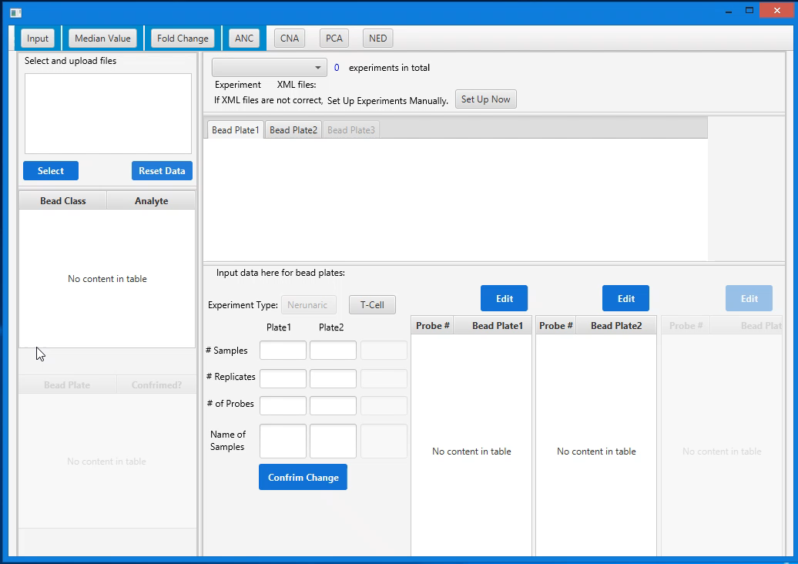
Demo – Input Setting
Notes:
First a user selects inputs, default Parameters are then automatically set up on the input page, Such as # of experiments, # of samples, # of replicas, # of probes, and Probes names. Those default settings can be changed in seconds.
Moreover, this project provides vitalization of analysis setting, with plates represent wells and colors indicate probes, users can easily validate the setting up for a QMI analysis.

Slide 19
Demo – Median Value
Provides statistical evidence to validate the raw data in XML files
Supplementary Materials for Multiplex matrix network analysis of protein complexes in the human TCR signalosome. 2015
Notes:
endian value provides statistical evidences to validate the raw data in XML files. because If half the data are contaminated, the median will give an arbitrarily large or small result. These contaminated data will not be considered in future analyses.

Slide 20
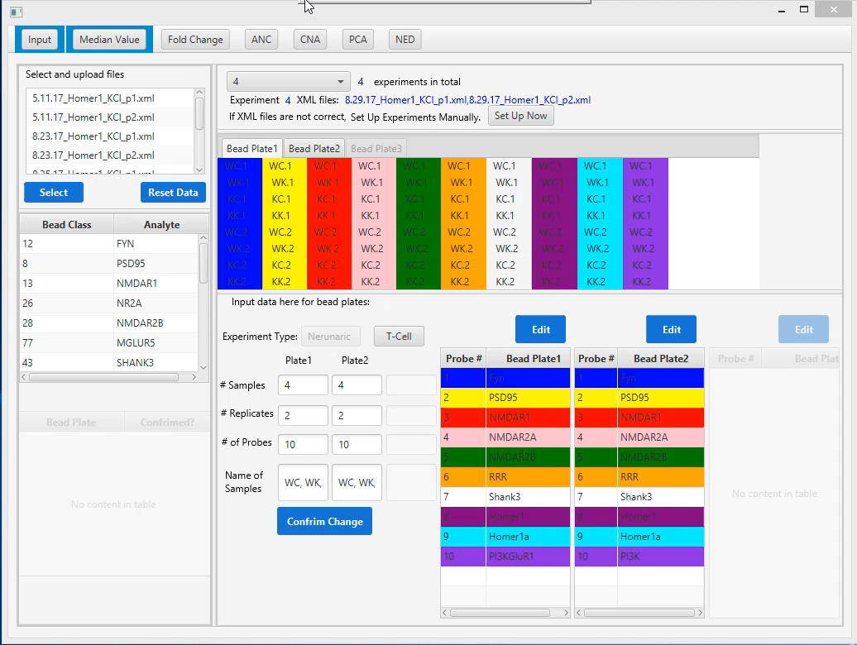
Demo – Median Value
Notes:
A User clicks the corresponding Tab on the menu bar, and then select a sample to view results. The results are color-coded to highlight outstanding data. The more red the color, the more unusual the data.

Slide 21
Demo – Fold Change
Filters weakly detected or weakly changed sample interactions
Supplementary Materials for Multiplex matrix network analysis of protein complexes in the human TCR signalosome. 2015
Notes:
Fold change is used to compare the expression of genes between two samples.
Since fold change data exceeding a threshold indicates weakly detected or weakly changed interactions. That means the two protein does not interact with each other.

Slide 22
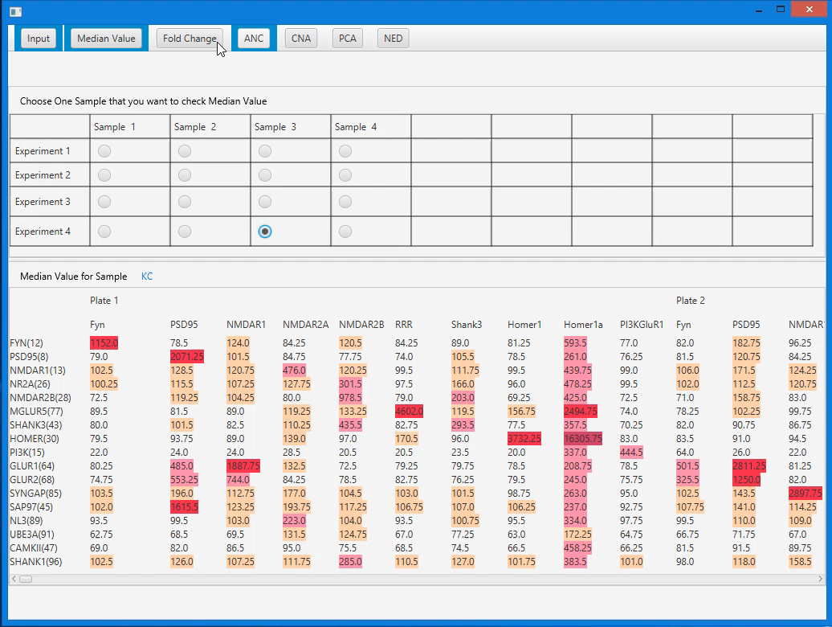
Demo – Fold Change
Notes:
A User clicks the FC panel , and then select sample(s) to view results. The results are color-coded to highlight outstanding data base on the cut off value. A user can change the cut off value. Data highlighted in red and blue indicates weakly or no interactions between the two proteins. The more intense the color, the less interaction detected.

Slide 23
Demo – Adaptive nonparametric analysis(ANC)
Use Kolmogorov–Smirnov test (KS Test) to define statistical significance, which means high-confidence in detecting autoreactive T-cells signaling.
Supplementary Materials for Multiplex matrix network analysis of protein complexes in the human TCR signalosome. 2015
Notes:
Adaptive nonparametric analysis(ANC)
ANC uses 2-sided KS test to calculate P value and define statistical significance. the threshold value is 0.05. if a p value higher than 0.05, it means high confidence in detecting autoreactive t cell signaling. In another word, the combination of proteins may works for T cell activation. Those data are colored in blue with different intensity. For p value less that 0.05, that should be presumed as manual errors and not be considered. They are colored in red.

Slide 24
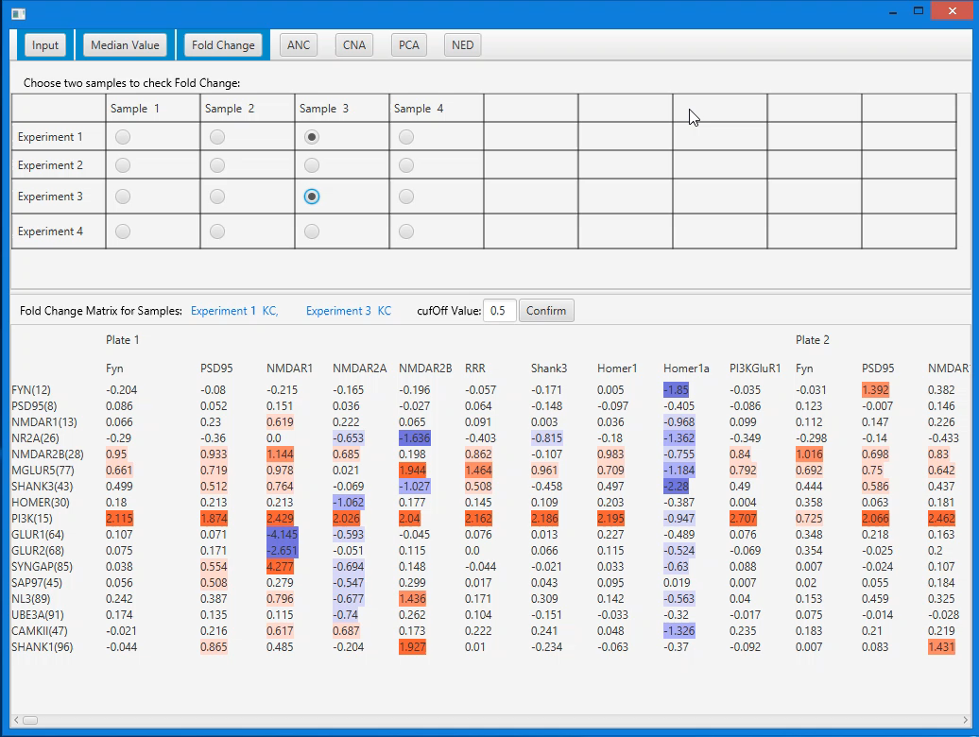
Demo – ANC
Notes:
Similarly, a User clicked the ANC panel and chose a sample to check ANC value with color coded presentation.

Slide 25
Demo – Flexibility
Supplementary Materials for Multiplex matrix network analysis of protein complexes in the human TCR signalosome. 2015
Notes:
Besides visual presentation of data and results, we also provide Flexibility that current QMI platform lacks.
user can go back to check previous results. They can also make changes to set up parameters at anytime.

Slide 26
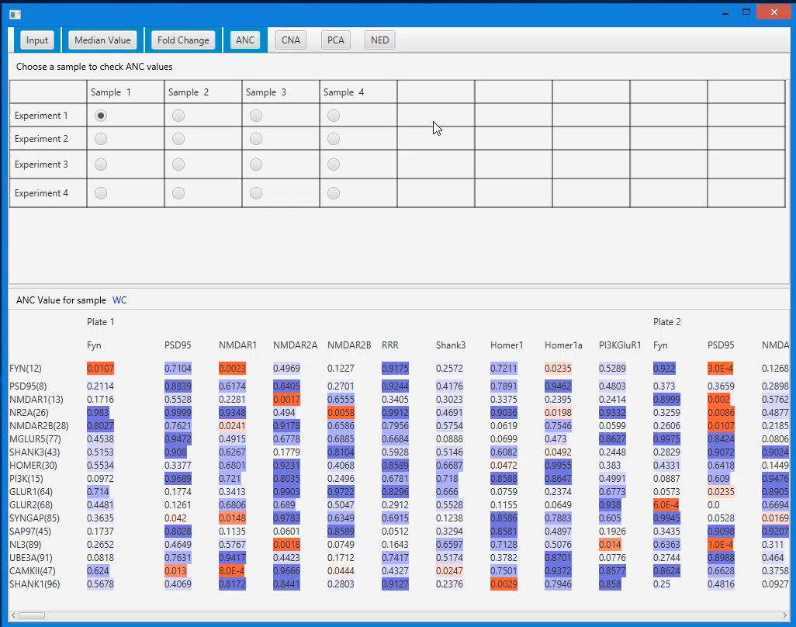
Demo – Flexibility

Slide 27
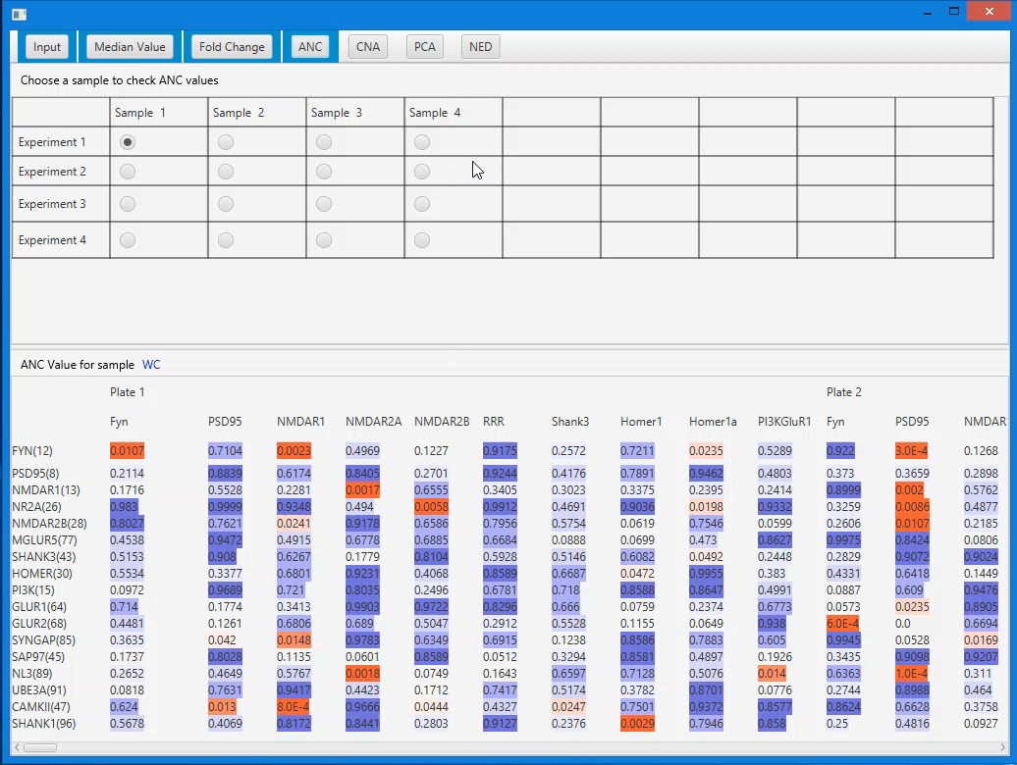
Demo – Flexibility
Notes:
Here is a demo shows the flexibility.
We have presented our project and demos, now I am going to show how we evaluated the project.

Slide 28



Evaluation – Metrics
Correctness
Effectiveness
Completion rate
Task time
User satisfaction
Usability survey
Notes:
We use 3 metrics to evaluate this program.
First. Correctness. The results of our project should be identical to the results provided by clients or produced on MATLAB.
Second, effectiveness. We expect our project can handle complex setting cases and provide fast response. So we choose completion rate and task time to measure effectiveness.
Third, usability is very important for users to adopt QMI platform. we plan to have a usability survey to get comments and suggestions from users and make improvements accordingly. Since we did not finished this project, we will postpone the user survey until we finish our project.

Slide 29
Evaluation – Correctness
Correctness. We conducted 4 set of QMI analyses to check whether results are identical as the existing QMI platform. The results are 100% correct.
QMI analysis | Setting parameters | Correct?
1 | 1 experiment with 2 XML files. | Y
2 | 2 experiments with 4 XML files. | Y
3 | 3 experiments with 6 XML files. | Y
4 | 4 experiments with 8 XML files. | Y
Notes:
We used 4 set of QMI analyses to check and compare the results. The result are 100% correct.

Slide 30
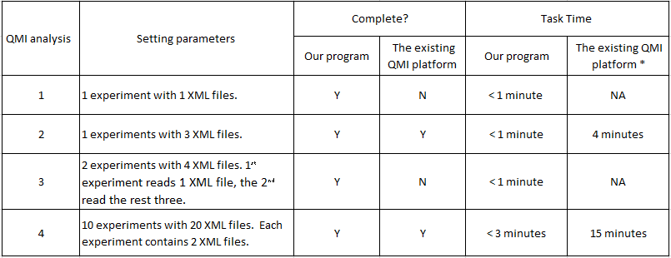
Evaluation – Effectiveness
Effectiveness. We conducted 4 set of QMI analyses with unusual settings to check whether our project able to complete. The test cases all passed. The completion rate is 100%. Task time is satisfying.
Notes:
We used another 4 set of QMI analyses with unusual settings to check whether the project able to complete.
The test cases all passed, the completion rate for our project is 100%. which only 50% for existing platform.
Because for case 2 and 4, we will need to make major coding changes to run the QMI analysis successfully.
Additionally, the task time using our project is satisfying. we performed normal analyses within 1 min, and less than 3 mins for a complex QMI analysis which has 20 input files. Using the exiting QMI platform, even operated by an expert, it takes at least 4 min for a normal case.

Slide 31

Evaluation – Goals achieved?
Integration of scattered tools into a unified graphical user interface program
Fast responses
Meaningful visualizations
User-friendly interfaces
Notes:
So far we have implemented input panel and 3 analyses. Overall, we’ve achieved goals for our project,
We integrated scatter tools into a unified GUI and provided a streamlined analysis process,
we chosen a MVC architecture and right data structures to provide fast response.
we use user-centered design to provide user-friendly interfaces so that users can easily upload input data and click through to perform QMI analysis by themselves.
we also highlight on meaningful visualizations to help users understand the data and results.
Next I will present future works.

Slide 32
Future Works
Implement “CAN”, “PCA” and “NED” analyses
Conduct an usability survey to get comments and suggestions for improvements
Install our product into end user labs, prepare technical documentation for future maintenance, and arrange trainings for end users
Notes:
For future work, first, we need to continue on implementing the remaining 3 analyses.
2nd, after we finish implementation and testing, we shall have an usability survey to get comments and suggestions for improvement.
Finally, we have to install our product into end user labs, prepare technical documentation for maintenance, and provide trainings for end users.

Slide 33
Acknowledgments
Prof. Kim for her guidance in this project, as well as proofreading and valuable suggestions on the project paper and the project presentation.
Prof. Yang and Prof. Geetha, for being a member of my Capstone project Committee.
Prof. Kool for her writing suggestions on the project paper and project presentation.
Prof. Smith, a Professor of department of pediatric, graduate program in neuroscience, for support and suggestions on this project.
Notes:
Finally, I'd like to thank everyone who involved in my capstone project.
I want to thank Professor Kim for your wonderful guidance in this project, and proofreading and valuable suggestion for my paper and presentation.
I want to thank Professor Yang and Professor Geetha for being a member of my capstone committee and spend time for me.
I also want to thank Prof. Kool for helping me with my paper writing and presentation.
Last but not the least, I want to thank my client, professor Smith, for his support and suggestions on our project.

Slide 34
References
Smith, S. E., Neier, S. C., Reed, B. K., Davis, T. R., Sinnwell, J. P., Eckel-Passow, J. E.& Neuhauser, C. (2016). Multiplex matrix network analysis of protein complexes in the human TCR signalosome. Sci. Signal., 9(439), rs7-rs7.
[1] Smith, S. E., Neier, S. C., Reed, B. K., Davis, T. R., Sinnwell, J. P., Eckel-Passow, J. E. & Neuhauser, C. (2016). Supplementary Materials for Multiplex matrix network analysis of protein complexes in the human TCR signalosome. Sci. Signal., 9(439), rs7-rs7.
The R Project for Statistical Computing. https://www.r-project.org/about.html
Jones, S., & Thornton, J. M. (1995). Protein-protein interactions: a review of protein dimer structures. Progress in biophysics and molecular biology, 63(1), 31-65.
Douglass, A. D., & Vale, R. D. (2005). Single-molecule microscopy reveals plasma membrane microdomains created by protein-protein networks that exclude or trap signaling molecules in T cells. Cell, 121(6), 937-950.
Wiederschain, G. Y. (2006). Protein-protein interactions. A molecular cloning manual. Biochemistry (Moscow), 71(6), 697-697.
Khatib-Shahidi, S., Andersson, M., Herman, J. L., Gillespie, T. A., & Caprioli, R. M. (2006). Direct molecular analysis of whole-body animal tissue sections by imaging MALDI mass spectrometry. Analytical chemistry, 78(18), 6448-6456.
Pemble, S., Schroeder, K. R., Spencer, S. R., Meyer, D. J., Hallier, E., Bolt, H. M., & Taylor, J. B. (1994). Human glutathione S-transferase theta (GSTT1): cDNA cloning and the characterization of a genetic polymorphism. Biochemical Journal, 300(Pt 1), 271.
Sato, T., Hanada, M., Bodrug, S., Irie, S., Iwama, N., Boise, L. H., & Wang, H. G. (1994). Interactions among members of the Bcl-2 protein family analyzed with a yeast two-hybrid system. Proceedings of the National Academy of Sciences, 91(20), 9238-9242.
Sekar, R. B., & Periasamy, A. (2003). Fluorescence resonance energy transfer (FRET) microscopy imaging of live cell protein localizations. The Journal of cell biology, 160(5), 629-633.
The SPES Lab. http://faculty.washington.edu/seps/SEPS_Lab/The_SEPS_Lab.html
Mahe, E., Pugh, T., & Kamel-Reid, S. (2017). T cell clonality assessment: past, present and future. Journal of clinical pathology, jclinpath-2017.
Kuroda, K., Kato, M., Mima, J., & Ueda, M. (2006). Systems for the detection and analysis of protein–protein interactions. Applied microbiology and biotechnology, 71(2), 127-136.
Topalian, S. L., Drake, C. G., & Pardoll, D. M. (2015). Immune checkpoint blockade: a common denominator approach to cancer therapy. Cancer cell, 27(4), 450-461.

Slide 35
References
Maude, S. L., Teachey, D. T., Porter, D. L., & Grupp, S. A. (2015). CD19-targeted chimeric antigen receptor T-cell therapy for acute lymphoblastic leukemia. Blood, 125(26), 4017-4023.
Lee, D. W., Kochenderfer, J. N., Stetler-Stevenson, M., Cui, Y. K., Delbrook, C., Feldman, S. A., & Steinberg, S. M. (2015). T cells expressing CD19 chimeric antigen receptors for acute lymphoblastic leukaemia in children and young adults: a phase 1 dose-escalation trial. The Lancet, 385(9967), 517-528.
Porter, D. L., Hwang, W. T., Frey, N. V., Lacey, S. F., Shaw, P. A., Loren, A. W., & Ambrose, D. (2015). Chimeric antigen receptor T cells persist and induce sustained remissions in relapsed refractory chronic lymphocytic leukemia. Science translational medicine, 7(303), 303ra139-303ra139.
Yeger-Lotem, E., & Sharan, R. (2015). Human protein interaction networks across tissues and diseases. Frontiers in genetics, 6, 257.
Rosenberg, S. A., Packard, B. S., Aebersold, P. M., Solomon, D., Topalian, S. L., Toy, S. T., & Simpson, C. (1988). Use of tumor-infiltrating lymphocytes and interleukin-2 in the immunotherapy of patients with metastatic melanoma. New England Journal of Medicine, 319(25), 1676-1680.
Rosenberg, S. A., Aebersold, P., Cornetta, K., Kasid, A., Morgan, R. A., Moen, R., & Merino, M. J. (1990). Gene transfer into humans—immunotherapy of patients with advanced melanoma, using tumor-infiltrating lymphocytes modified by retroviral gene transduction. New England Journal of Medicine, 323(9), 570-578.
Topalian, S. L., Solomon, D., Avis, F. P., Chang, A. E., Freerksen, D. L., Linehan, W. M., & Simon, P. (1988). Immunotherapy of patients with advanced cancer using tumor-infiltrating lymphocytes and recombinant interleukin-2: a pilot study. Journal of Clinical Oncology, 6(5), 839-853.
Lymphatic system and immunity. https://www2.estrellamountain.edu/faculty/farabee/biobk/BioBookIMMUN.html
Sherwood, L. (2011). Fundamentals of human physiology. Cengage Learning
Griffiths, A. J. (2005). An introduction to genetic analysis. Macmillan.
Sudhakar, A. (2009). History of cancer, ancient and modern treatment methods. Journal of cancer science & therapy, 1(2), 1.
Janeway, C. A. (2001). How the immune system works to protect the host from infection: a personal view. Proceedings of the National Academy of Sciences, 98(13), 7461-7468.
How T cells work. https://www.youtube.com/watch?v=kIxmiTuRydw

Slide 36
References
Krasner, G. E., & Pope, S. T. (1988). A description of the model-view-controller user interface paradigm in the smalltalk-80 system. Journal of object oriented programming, 1(3), 26-49.
McDonough, J. E. (2017). Singleton Design Pattern. In Object-Oriented Design with ABAP (pp. 137-145). Apress, Berkeley, CA.
Kataoka, K. (2006). U.S. Patent No. 7,013,425. Washington, DC: U.S. Patent and Trademark Office.
Iterative Model: What Is It and When Should You Use It. https://airbrake.io/blog/sdlc/iterative-model
Median. https://en.wikipedia.org/wiki/Median
The Human Defense System. http://leavingbio.net/human-defence-system/

Slide 37
Thanks For Your Time! Questions?
Notes:
That ‘s the presentation of my project. Thank you very much for your attention.
Any questions?

